Slide 1

Object Oriented Programming Windows Tutorials Tutorial #2 : Display a Bitmap
Department of Computer Science and Information Engineering
Shuo-Han Chen (陳碩漢), shchen@csie.ntut.edu.tw
Hong-Yue Technology Research Building 1223
F 09:10 - 12:00
Notes:
Good Afternoon everyone
I am Shuo-Han Chen, a postdoctoral research fellow at Academia Sinica
It is a great honor to be invited by the department for being here today

Slide 2

Part I.
Game Framework 4.10使用說明 Visual Studio 2017
練習2A：在Game 的畫面中，顯示已建立Resource 的圖形
Notes:
Thank you for listening. Now, I would like to end today’s talk by the Q & A time.

Slide 3
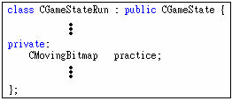
請先完成練習1A 或1B
宣告圖形物件：在mygame.h 檔案中找到“CGameStateRun” class 加入：

Slide 4
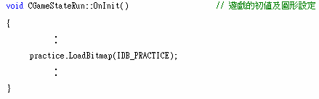
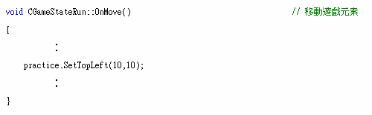
3.使用圖形物件：在mygame.cpp 檔案中找到，
(a) 載入Resource：CGameStateRun::OnInit() 加入：
(b) 指定圖形的座標：CGameStateRun::OnMove()加入：

Slide 5
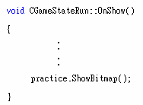
(c) 將圖形貼到螢幕：CGameStateRun::OnShow()加入：
(特別注意要加在OnShow的最後面，免得圖被其他的圖蓋住)

Slide 6
4. Compile->Run

Slide 7
Part II.
Game Framework 4.10使用說明 Visual Studio 2017
練習2B：在Game 的畫面中，顯示已建立檔案(bmp 檔)的圖形
Notes:
Thank you for listening. Now, I would like to end today’s talk by the Q & A time.

Slide 8
請先完成練習1C。
宣告圖形物件：在mygame.h 檔案中找到“CGameStateRun” class 加入：
8
Notes:
Here is more detail about me. I started working as a postdoctoral research fellow at the Institute of Information Science, Academia Sinica since March 2018
During my fellowship, I have been to the Purdue University USA and the Chinese University of Hong Kong for visiting
Before my fellowship, I spent two and half years for my phd degree at the CS Department of National Tsing Hua University
My research interests mainly lies in
the next generation memory/storage architecture designs
Emerging non-volatile memory and storage technologies
Low power system designs for artificial neural networks
In the past few years, I have revived few awards and a best paper nomination at DAC conference, which is a top rated conference in the EDA field

Slide 9
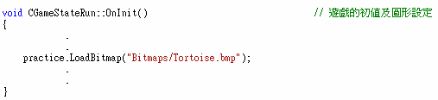
3.使用圖形物件：在mygame.cpp 檔案中找到，
(a) 載入Resource：CGameStateRun::OnInit() 加入：
目錄若用「\」表示時，應寫為practice.LoadBitmap(”Bitmaps\\Tortoise.bmp”)。
切忌使用絕對路徑如”c:\\xxx\\xxx.bmp”。

Slide 10
(b) 指定圖形的座標：CGameStateRun::OnMove()加入：
(c) 將圖形貼到螢幕：CGameStateRun::OnShow()加入：
(特別注意要加在OnShow的最後面，免得圖被其他的圖蓋住)

Slide 11
4. Compile->Run

Slide 12
Part III.
練習2C: 處理圖片的「透明色」(不顯示部分圖片)
Notes:
Thank you for listening. Now, I would like to end today’s talk by the Q & A time.

Slide 13

1.根據練習1A 或1B 加入一張以白色為透明色的點陣圖。範例圖如下，其中藍色是要顯示的，而白色則是透明的，也就是說，白色部分不會被顯示。
註：以1C 的方法載入也可以，但是以下說明是配合1A 或1B 寫的，因此，如果用1C 的話，請自行調整。
2.參考練習2A 宣告圖形物件及使用圖形物件。將上圖以不透明的方式顯示出來。

Slide 14
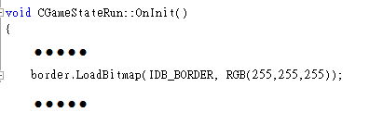
3.修改CGameStateRun::OnInit 中LoadBitmap 傳入的參數。
範例圖中白色是透明色，所以LoadBitmap 時，第二個參數傳入RGB(255,255,255)，表示白色是透明色(如果沒有第二個參數的話，整張圖都是不透明的)。

Slide 15
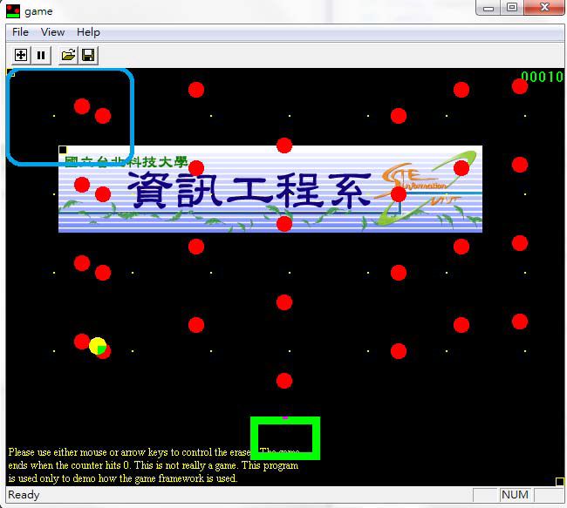
4. Compile->Run(白色的部分被設為透明色所以不顯示)

